Slide 1

Group & Team Theory
Session III

Slide 2

Group & Team Theory
1. Power in Teams and Groups

Slide 3

Learning Objectives
Explain different conceptualizations of power
Discuss behaviors associated with high status in a group
Differentiate between the common power bases in groups
What is the nature of leadership and the leadership process

Slide 4
Learning Objectives
How do leaders influence and move their followers to action?
What are the trait perspectives on leadership?
How do different approaches and styles of leadership impact what is needed now?

Slide 5

Power in Teams and Groups

Slide 6
Defining Power
  Power-Over
  Power-from-Within
“Power lives in relationships, not in people”
  Power-With

Slide 7
Defining Power
  Power-Over
If you associate power with control or dominance, this refers to the notion of power as power-over.
According to Starhawk (1987), “power-over enables one individual or group to make the decisions that affect others, and to enforce control” (p. 9).
“Power lives in relationships, not in people”

Slide 8
Defining Power
  Power-from-Within
Power-from-within refers to a more personal sense of strength or agency. Power-from-within manifests itself when we can stand, walk, and speak “words that convey our needs and thoughts” (Starhawk, 1987, p. 10).
In groups, this type of power “arises from our sense of connection, our bonding with other human beings, and with the environment” (10).
“Power lives in relationships, not in people”

Slide 9
Defining Power
  Power-With
Power-with refers to “the power of a strong individual in a group of equals, the power not to command, but to suggest and be listened to, to begin something and see it happen” (Starhawk, 1987, p. 10).
At least two qualities must be present among members:
All members must communicate respect and equality for one another
Leader must not abuse power-with and attempt to turn it into power-over.
“Power lives in relationships, not in people”

Slide 10
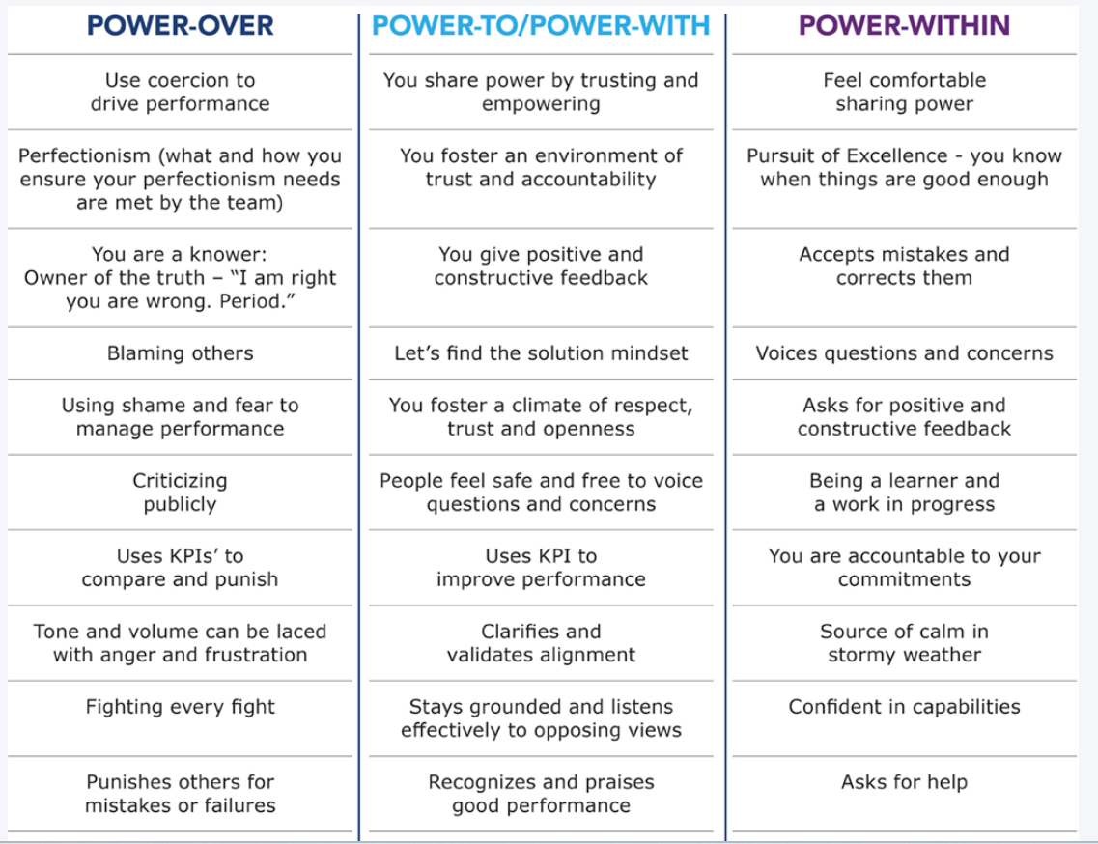
https://www.stopatnothing.com/4-types-of-power/

Slide 11

UNDERSTANDING POWER AND OPPRESSION
Power and oppression can be said to be mirror reflections of one another in a sense or two sides of the same coin.

Slide 12
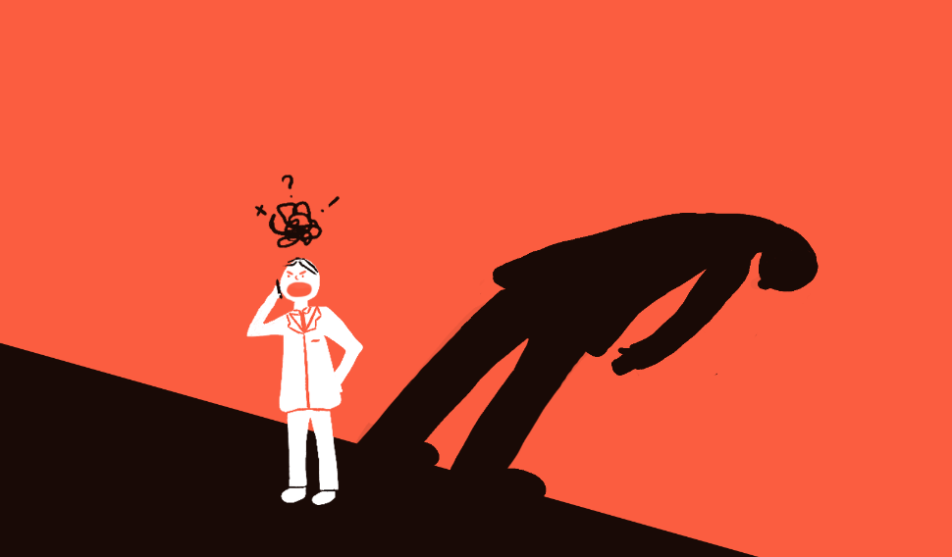
Relationship between Power and Status
STATUS
Can be defined as a person’s perceived level of importance or significance within a particular context.
POWER
Members with higher status are apt to command greater respect and possess more prestige and power than those with lower status.

Slide 13
BASES OF POWER IN GROUPS
  Referent Power
  Legitimate Power
  Reward Power
  Coercive Power
  Expert Power

Slide 14

Bases of Power in Groups
Referent Power - Person B looks up to or admires person A, and, as a result, B follows A largely because of A’s personal qualities, characteristics, or reputation. Person A can use referent power to influence B.
Referent power has also been called charismatic power, because allegiance is based on interpersonal attraction of one individual for another.

Slide 15

Bases of Power in Groups
Expert power is demonstrated when person A gains power because A has knowledge or expertise relevant to B.
For instance, professors presumably have power in the classroom because of their mastery of a particular subject matter.
In each case, the individual has credibility in a particular-and narrow-area as a result of experience and expertise, and this gives the individual power in that domain.
Stay hungry.
Stay foolish.
- Steve Jobs

Slide 16

Bases of Power in Groups
Reward power exists when person A has power-over person B because A controls rewards that B wants.
Research has indicated that reward power often leads to increased job performance as employees see a strong performance-reward contingency (Shetty, 1978).

Slide 17
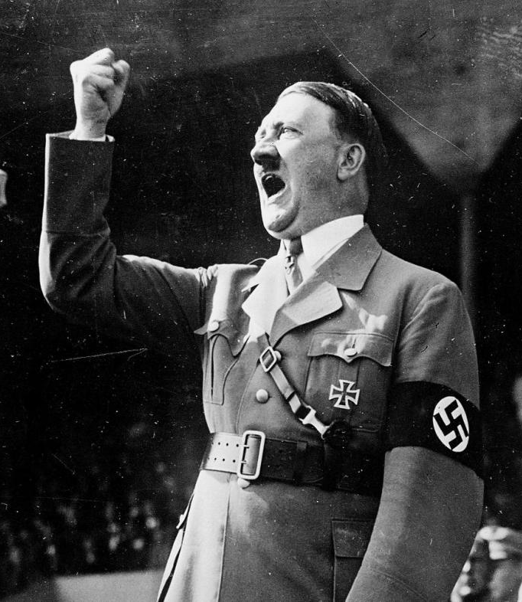
Bases of Power in Groups
Coercive power is based primarily on fear. Here, person A has power over person B because A can administer some form of punishment to B. Thus, this kind of power is also referred to as punishment power.
Coercive power does not have to rest on the threat of violence. “Individuals exercise coercive power through a reliance upon physical strength, verbal facility, or the ability to grant or withhold emotional support from others. These bases provide the individual with the means to physically harm, bully, humiliate, or deny love to others” (Kipnis, 1976).

Slide 18
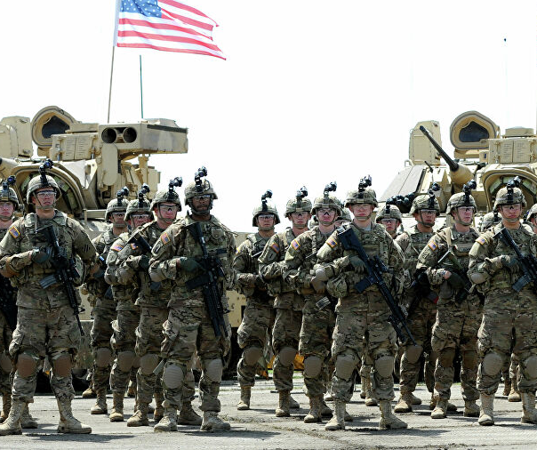
Bases of Power in Groups
Legitimate power exists when person B submits to person A because B feels that A has a right to exert power in a certain domain (Tjosvold, 1985). Legitimate power is really another name for authority.
Legitimate power differs from reward and coercive power in that it depends on the official position a person holds, and not on his or her relationship with others.

Slide 19
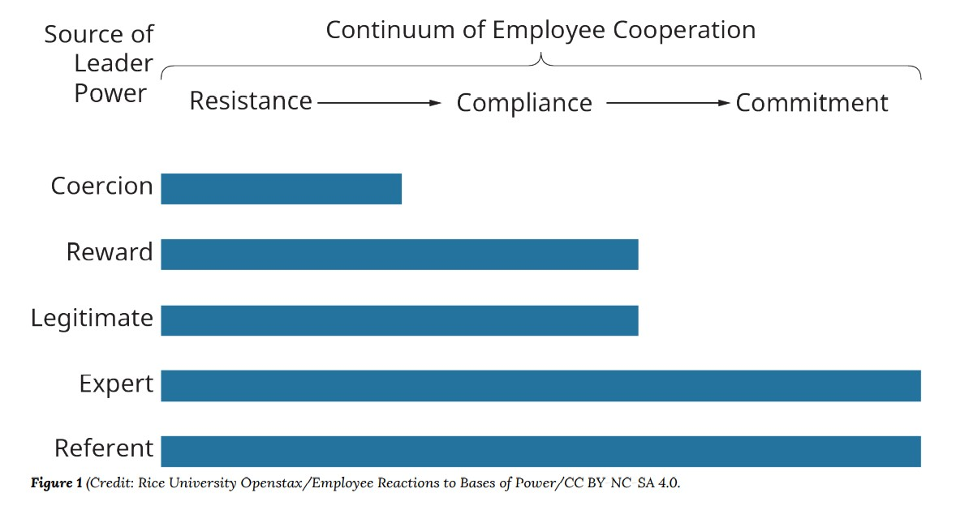
Consequences of Power

Slide 20
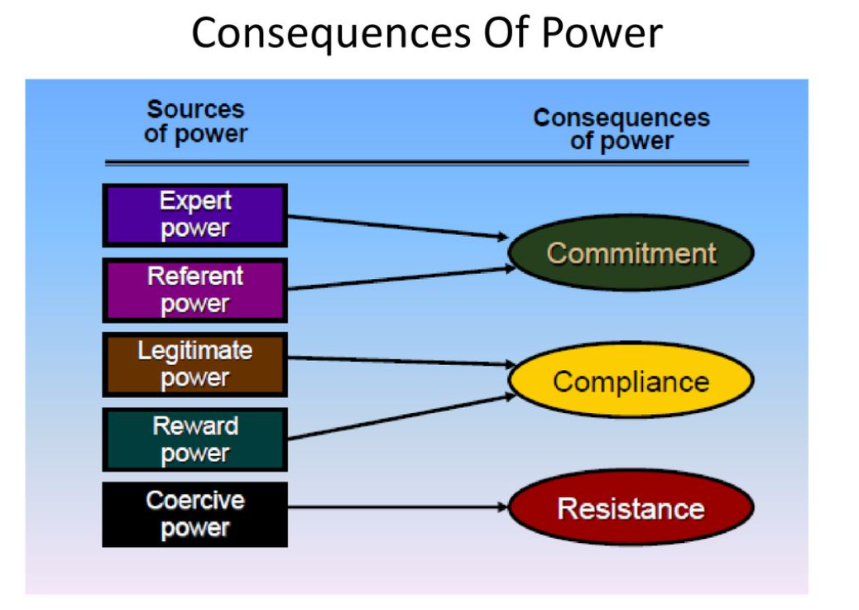

Slide 21

Power Dependencies
In any situation involving power, at least two persons (or groups) can be identified:
  The person attempting to influence others
  The target (targets) of that influence.
All people are not subject to (or dependent upon) the same bases of power.

Slide 22

What causes some people to be vulnerable to power attempts?

Slide 23
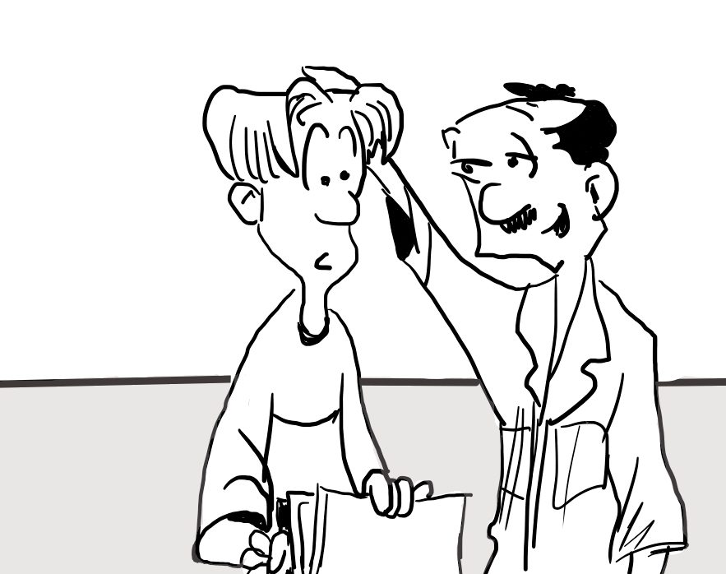
What causes some people to be vulnerable to power attempts?
Subordinate’s Values
Person B’s values can influence his susceptibility to power.
If an employee places a high value on money and believes the supervisor actually controls pay raises, we would expect the employee to be highly susceptible to the supervisor’s influence.

Slide 24
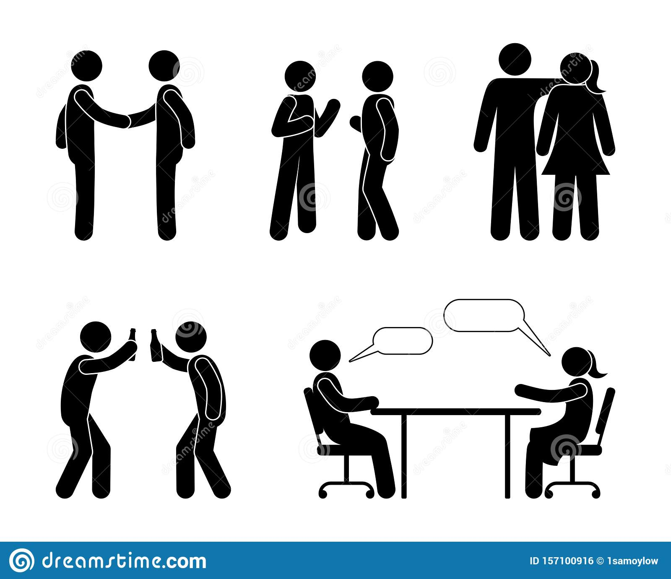
What causes some people to be vulnerable to power attempts?
Nature of Relationship
The nature of the relationship between A and B can be a factor in power dependence.
Are A and B peers or superior and subordinate?
Is the job permanent or temporary?
A person on a temporary job, for example, may feel less pressure to comply because he will not be in the position for long.

Slide 25
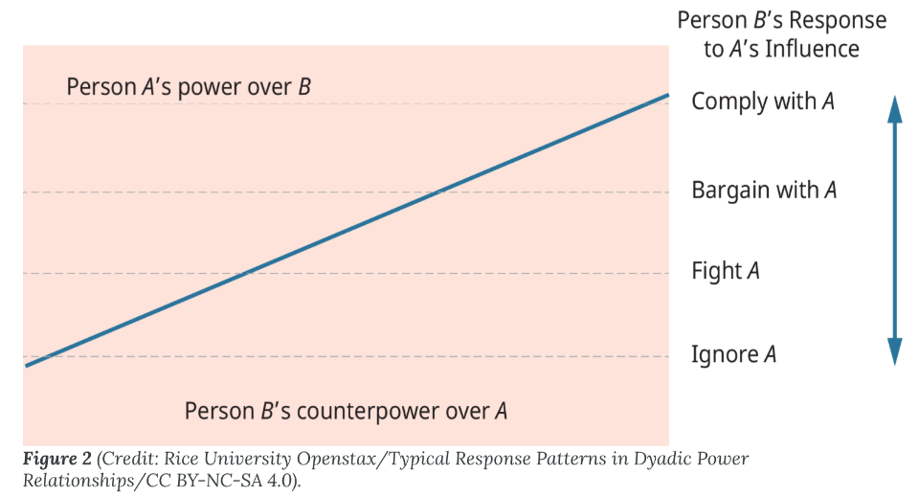
What causes some people to be vulnerable to power attempts?
Counterpower
B has other sources of power to buffer the effects of A’s power. For example, if B is unionized, the union’s power may serve to negate A’s influence attempts.

Slide 26

Uses of Power: Common Power Tactics in Organizations
It is easy to see manifestations of power almost anywhere. In fact, there are a wide variety of power-based methods used to influence others.
We will examine two aspects of the use of power: commonly used power tactics and the ethical use of power.
Controlling Access to Person
Selective Use of Objective Criteria
Using Outside Experts
Coalitions and Alliances
Controlling Access to Information
Controlling the Agenda
Bureaucratic Gamesmanship

Slide 27

Uses of Power: Ethical Use of Power
Basis of power: Referent power
Guidelines for Use:
Treat subordinates fairly
Defend subordinates’ interests
Be sensitive to subordinates’ needs, feelings
Select subordinates similar to oneself
Engage in role modeling

Slide 28
Uses of Power: Ethical Use of Power
Basis of power: Expert power
Guidelines for Use
Promote the image of expertise
Maintain credibility
Act confident and decisive
Keep informed
Recognize employee concerns
Avoid threatening subordinates’ self-esteem

Slide 29
Uses of Power: Ethical Use of Power
Basis of power: Legitimate power
Guidelines for Use
Be cordial and polite
Be confident
Be clear and follow up to verify understanding
Make sure request is appropriate
Explain reasons for request
Follow proper channels
Exercise power regularly
Enforce compliance
Be sensitive to subordinates’ concerns

Slide 30
Uses of Power: Ethical Use of Power
Basis of power: Reward power
Guidelines for Use
Verify compliance
Make feasible, reasonable requests
Make only ethical, proper requests
Offer rewards desired by subordinates
Offer only credible rewards

Slide 31
Uses of Power: Ethical Use of Power
Basis of Power: Coercive power
Guidelines for Use:
Inform subordinates of rules and penalties
Warn before punishing
Administer punishment consistently and uniformly
Understand the situation before acting
Maintain credibility
Fit punishment to the infraction
Punish in private

Slide 32

Reflection Question
When you first joined your group,
What assumptions did you make about the status of different members?
Where did those assumptions come from?

Slide 33

Q&A

Slide 34
When does a person obtain the expert power?
A. Person A has higher status than person B
B. Person A has more expertise knowledge than person B
C. Person A group is bigger than person B
D. Person A has more friend than person B

Slide 35
Which of the following idioms can be used to describe the relationship between power and oppression.
A. A blessing in disguise
B.The best of both worlds
C. Get out of hand
D. Two sides of the same coin

Slide 36
“Arises from our sense of connection, our bonding with other human beings, and with the environment” can be used to describe which type of power.
A. Power-from-within
B. Power-with
C. Power-over
D. None of these answers

Slide 37
QUESTION : You are the Project Manager of a project involving building a computer. Your team members follow what you tell them because you have the authority to provide negative feedback in their performance appraisal. This is an example of which type of power?
A. Legitimate
B. Referent
C. Coercive
D. Reward

